Slide 1
Divine Intervention
Religious Brand Names Strengthen Self-Brand Connection
Associate Professor Jasmina Ilicic, Monash University
Associate Professor Stacey Brennan, University of Sydney

Slide 2
Brand Names
Communicate meaning to influence perceptions, memory, attitudes, and behaviour (Carnevale, Luna, and Lerman 2017)
Spiritual words often used as brand names
Research yet to examine the effect of spiritual brand name primes on consumer brand perceptions and relationships

Slide 3
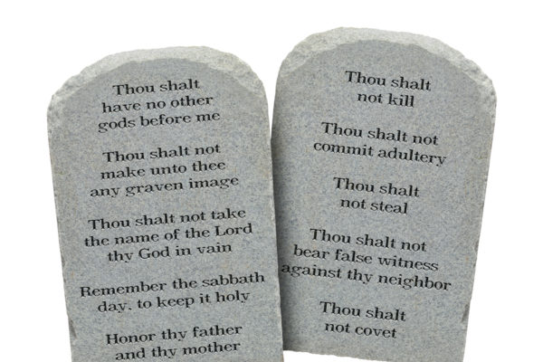
Religious Priming
Affects morality judgments based on character behaviour
Good/Bad
Right/Wrong

Slide 4
Religious Priming
Affects morality judgments based on character behaviour
Good/Bad
Right/Wrong
Associative Priming
Religious
Brand Name
Brand Morality
Perceptions

Slide 5
Self-Brand Connection
Subjective personal relationship formed when a brand is incorporated into self-concept
Moral self identify = set of moral traits central to self-concept
Morality perceptions influence self-brand connection
Moral
Self-Identity
Brand Morality
Perceptions
Religious
Brand Name
Self-Brand Connection

Slide 6
The Role of Colour
Color can influence meaning, judgments and behavior
Black = Immoral
Gratify
Gratify

Slide 7
The Role of Colour
Colour can influence meaning, judgements and behaviour
Black = Immoral
Gratify
Gratify
Black Logo Colour
Moral
Self-Identity
Brand Morality
Perceptions
Religious
Brand Name
Self-Brand Connection

Slide 8
Overview of Studies
Study 1
Examine the effect of religious brand names on brand morality
Study 2
Examine self-brand connection as an outcome of brand morality
Examine the conditional effect of morality identity
Study 3
Examine conditional effect of brand logo colour

Slide 9
Study 1: Brand Morality
Sample and Design
170 members of general population
82 male, 67 female, 1 other/not specified; M_{Age} = 35.89
Recruited via mTurk
Between subjects experimental design:
Religious brand name (n = 75)
Control brand name (n = 75)
Procedure
View brand name
Rate brand morality
Rate brand religiosity (manipulation check)

Slide 10
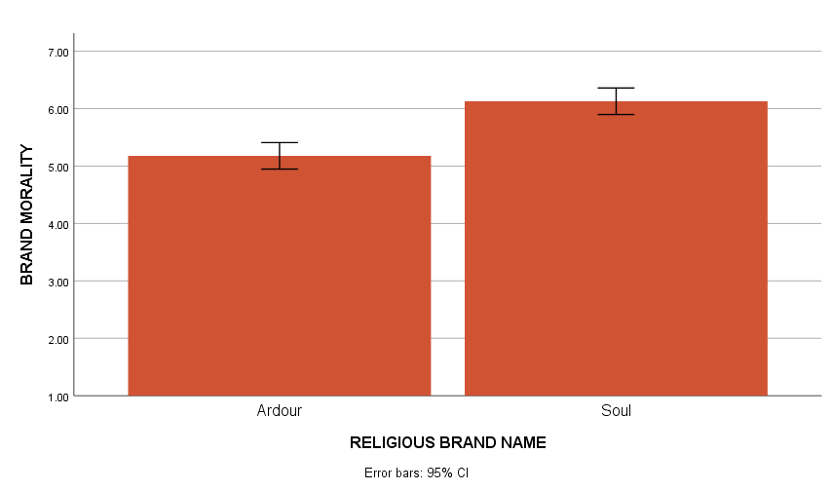
Study 1: Results
M = 4.48, SD = 1.23
6.13
M = 4.03, SD = 1.24
5.18
F(1, 148) = 33.07, p < .001, η² = .183

Slide 11
Study 2: Self-Brand Connection and Moral Identity
Sample and Design
140 members of general population
74 male, 66 female; M_{Age} = 36.51
Recruited via mTurk
Between subjects experimental design:
Religious brand name (n = 70)
Control brand name (n = 7-)
Procedure
View brand name
Rate self-brand connection
Rate brand morality
Rate brand religiosity (manipulation check)

Slide 12
Study 2: Self-Brand Connection and Moral Identity
Moral
Self-Identity
Brand Morality
Perceptions
Religious
Brand Name
Self-Brand Connection

Slide 13
Study 3: Results
Predictors: | Beta | t | p
Dependent Variable: Brand Morality (Model 1; R²=.10, p <.001)
Religious Brand Name Prime (X) | .64 | 3.86 | <.001
Dependent Variable: Self-Brand Connection (Model 2; R²=.47, p <.001))
Religious Brand Name Prime (X) | .01 | .74 | .941
Brand Morality (M) | -.26 | -1.33 | .186
Moral Identity (W) | -.29 | -1.21 | .227
M x W | .14 | 3.16 | .002
M = 4.48, SD = 1.23
M = 4.03, SD = 1.24
Conditional Indirect Effect
Low moral identity (x̄ - 1SD): β = .10, 95% CI = -.15 to .38
Moderate moral identity (x̄): β = .26, 95% CI = .08 to .51
High moral identity (x̄ + 1SD): β = .37, 95% CI = .15 to .67

Slide 14
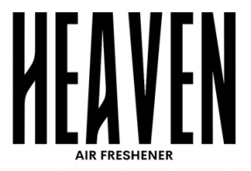
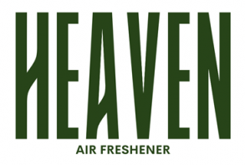
Study 3: Conditional Effect of Logo Colour
Sample and Design
277 members of general population
155 male, 122 female; M_{Age} = 36.45
Recruited via mTurk
2 (religious brand name prime) x 2 (brand logo colour)

Slide 15
Study 3: Conditional Effect of Logo Colour
Sample and Design
277 members of general population
155 male, 122 female; M_{Age} = 36.45
Recruited via mTurk
2 (religious brand name prime) x 2 (brand logo colour)
Procedure
View brand name
Rate self-brand connection
Rate brand morality
Rate brand religiosity (manipulation check)

Slide 16
Study 3: Conditional Effect of Logo Colour
Black Logo Colour
Moral
Self-Identity
Brand Morality
Perceptions
Religious
Brand Name
Self-Brand Connection

Slide 17
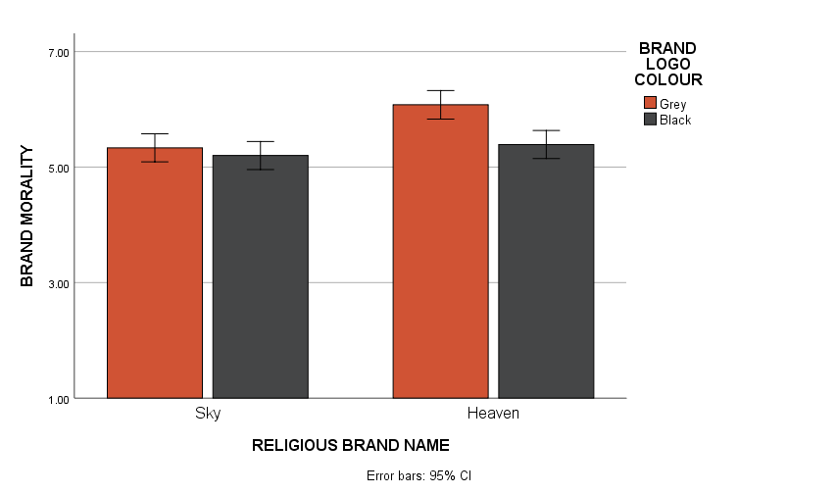
Study 3: Results
M = 4.48, SD = 1.23
M = 4.03, SD = 1.24
F(1, 274) = 5.01, p = .026, η² = .018

Slide 18
Study 3: Results
Predictors: | Beta | t | P
Dependent Variable: Brand Morality (Model 1; R²=.10, p <.001)
Religious Brand Name Prime (X) | .75 | 4.24 | <.001
Brand Logo Color (W) | -.13 | -.76 | .448
X x W | -.55 | -.2.23 | .026
Dependent Variable: Self-brand Connection (Model 2; R²=.54, p <.001)
Religious Brand Name Prime (X) | -.14 | -1.39 | .167
Brand Morality (M) | -.21 | -1.72 | .086
Moral Identity (Z) | .03 | .23 | .822
M x Z | .10 | 3.69 | <.001
M = 4.48, SD = 1.23
M = 4.03, SD = 1.24
Conditional Indirect Effect
Low moral identity (x̄ - 1SD): 95% CI = -.20 to .03
Moderate moral identity (x̄): 95% CI = -.31 to -.02
High moral identity (x̄ + 1SD): 95% CI = -.43 to -.03

Slide 19
Discussion
Discussion/Limitations
Initial evidence of effect of religious brand names on brand connection
Future research to look beyond predominately Christian cultures

Slide 20
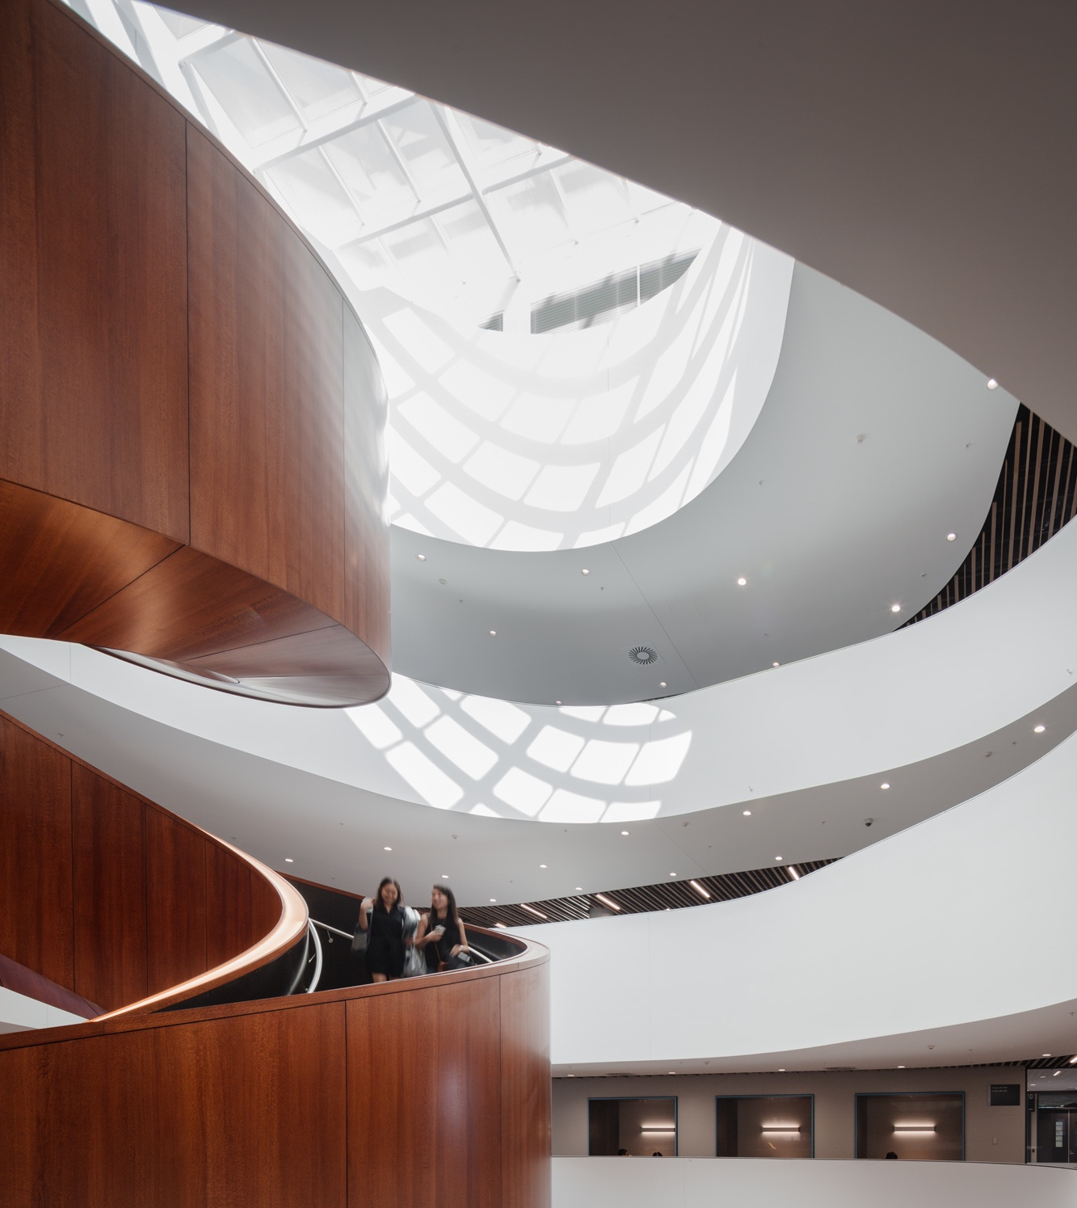
Any Questions?
The University of Sydney Business School
Business not as usual

